Slide 1
Al-Driven Public Health Chatbot for Disease Awareness - Medibot
CSE7302- Capstone Project Review-2
Batch Number: CSG_16 Under the Supervision of,
Mr. Asif Ahmad Najar
Assistant Professor
School of Computer Science and Engineering Presidency University
Name of the Program: CSG Name of the HoD: Dr . Pallavi
Name of the Program Project Coordinator: Ms Benitha Christinal J
Name of the School Project Coordinators: Dr. Sampath A K , Dr. Geetha A
Roll Number | Student Name
20221CSG0027 | SUZAIN PATEL
20221CSG0055 | ZAKIR AHMAD
20221CSG0022 | TARUN PANDIAN M
20221CSG0020 S Mohammed Affan
20221CSG0059 Karthik Mp
20221CSG0092 Chaithra C

Slide 2
Abstract
Access to accurate public health information remains a challenge, particularly for rural and semi-urban populations, where existing medical chatbots often generate unreliable or hallucinated responses due to weak factual grounding. To address this issue, this project proposes an AI-driven Public Health Chatbot for Disease Awareness using Retrieval-Augmented Generation (RAG) to deliver reliable, document-grounded health information.
The system is designed to educate users on preventive healthcare, disease symptoms, and vaccination-related information by retrieving content exclusively from trusted medical sources and generating responses strictly based on the retrieved context. The chatbot functions as an educational and decision-support tool, explicitly avoiding diagnosis or treatment recommendations to ensure safety and ethical compliance.
The proposed approach preprocesses authoritative medical documents, converts them into semantic vector embeddings, and stores them in a FAISS vector database for efficient retrieval. User queries submitted through the chatbot interface are matched against this knowledge base, and the retrieved content is used by a language model to generate accurate and context-aware responses. This architecture improves response reliability, reduces misinformation, and supports scalable deployment for controlled public health information dissemination, with future scope for real-time outbreak alerts and integration with official health data sources.

Slide 3
Literature Survey
This literature survey examines existing research on public health and healthcare chatbots, the application of large language models (LLMs) in medical information systems, and retrieval-augmented generation (RAG) techniques. Prior studies demonstrate that conversational agents improve accessibility and user engagement for health awareness and disease-related education; however, many existing systems rely on rule-based logic or shallow NLP methods, leading to limited contextual understanding and unreliable responses. Recent advances in LLMs highlight their strong natural language understanding and medical knowledge capabilities, but multiple studies identify hallucination as a major concern in safety-critical domains such as healthcare. RAG has emerged as an effective solution by integrating document retrieval with text generation to improve factual accuracy and reliability. Despite these advances, there remains a lack of document-grounded, RAG-based public health chatbots designed specifically for disease awareness and decision-support, motivating the proposed system.

Slide 4
Literature Survey
1. Laranjo et al., 2018 – Chatbots in Healthcare: A Systematic Review
This paper provides a systematic review of healthcare chatbots used for patient education, monitoring, and support. The authors report improved accessibility and engagement but observe that most systems are rule-based or rely on shallow NLP methods.
Impact on Our Design: This work justifies the use of a conversational chatbot for medical information delivery.
Gap Identified: Lack of contextual intelligence and factual grounding in responses.
2. Bickmore et al., 2018 – Safety First: Conversational Agents for Health Information
This paper studies conversational agents designed for general health information and public health awareness. The authors report that such chatbots improve accessibility and user engagement but raise safety concerns when responses are not properly validated.
Impact on Our Design: Justifies using a chatbot for disease awareness while emphasizing a non-diagnostic, decision-support role.
Gap Identified: Does not provide a technical framework to ensure factual grounding of chatbot responses.

Slide 5
Literature Survey
3. Wilson & Marasoiu, 2022 – The Development and Use of Chatbots in Public Health
This paper presents a scoping review of chatbots used in public health for disease awareness, preventive healthcare education, and vaccination communication. The authors report that chatbots improve accessibility and outreach, particularly in large and diverse populations.
Impact on Our Design: Directly supports the use of an AI chatbot for public health education and disease awareness.
Gap Identified: Most reviewed systems lack advanced AI grounding mechanisms and rely on predefined responses, limiting reliability and scalability.
4. Branda et al., 2025 – AI-Based Chatbots in Public Health Emergencies
This paper reviews AI-based chatbots used during infectious disease outbreaks and public health emergencies. The authors report that chatbots support real-time outbreak communication, disease awareness, and preventive guidance while reducing misinformation.
Impact on Our Design: Supports using AI chatbots for real-time public health communication and disease awareness.
Gap Identified: Does not present a technical mechanism to ensure response accuracy during rapidly evolving outbreaks.

Slide 6
Literature Survey
5. Singhal et al., 2023 – Large Language Models Encode Medical Knowledge
This paper shows that LLMs perform well on medical question answering and encode substantial medical knowledge.
Impact on Our Design: Justifies the use of an LLM for fluent and context-aware response generation.
Gap Identified: Standalone LLMs are prone to hallucinations, making them unsafe for medical use.
6. Ji et al., 2023 – A Survey of Hallucination in Natural Language Generation
The authors present an extensive analysis of hallucination in generative models, identifying healthcare as a high-risk domain.
Impact on Our Design: Motivates the use of document grounding and retrieval-based constraints.
Gap Identified: Primarily analytical; lacks a deployable mitigation solution.

Slide 7
Literature Survey
7. Lewis et al., 2020 – Retrieval-Augmented Generation
This foundational work introduces RAG, combining document retrieval with generation to improve factual accuracy in knowledge-intensive tasks.
Impact on Our Design: Forms the core methodology adopted in the proposed system.
Gap Identified: Originally designed for general NLP tasks, not medical documents.
8. Izacard & Grave, 2021 – Leveraging Passage Retrieval for QA
The study demonstrates that retrieval-based QA systems outperform generative-only approaches for factual tasks.
Impact on Our Design: Supports embedding-based semantic retrieval using FAISS.
Gap Identified: Evaluation limited to general datasets, not medical specimens.

Slide 8
Literature Survey
9. Miner et al., 2020 – Conversational AI in Healthcare
This review evaluates healthcare conversational agents and highlights issues related to transparency and trust.
Impact on Our Design: Reinforces the need for document-grounded responses.
Gap Identified: Does not provide a concrete technical architecture.
10. Devaraj et al., 2022 – Document-Grounded Clinical Decision Support
The authors propose document-backed AI systems for clinical decision support using medical evidence.
Impact on Our Design: Closely aligns with our document-grounded, decision-support approach.
Gap Identified: Lacks an interactive chatbot interface for users.

Slide 9
Literature Survey
Paper | Focus Area | Approach Used | Key Contribution | Identified Gap
Laranjo et al., 2018 | Healthcare chatbots | Systematic review | Validates chatbot use for health information | Mostly rule-based, low contextual intelligence
Bickmore et al., 2018 | Safe health information | Design & safety analysis | Emphasizes non-diagnostic chatbot design | No technical grounding mechanism
Wilson & Marasoiu, 2022 | Public health awareness | Scoping review | Shows chatbots improve disease awareness | Limited use of advanced AI
Branda et al., 2025 | Public health emergencies | Narrative review | Enables real-time outbreak communication | Accuracy assurance not addressed
Singhal et al., 2023 | Medical LLM capability | LLM evaluation study | Confirms strong medical knowledge in LLMs | Prone to hallucinated responses
Ji et al., 2023 | Hallucination risks | Survey study | Identifies hallucination as high risk in healthcare | No practical mitigation framework
Lewis et al., 2020 | Factual text generation | RAG framework | Introduces retrieval-grounded generation | Not domain-specific to healthcare
Izacard & Grave, 2021 | Retrieval-based QA | Passage retrieval + generation | Improves factual correctness | Tested on open-domain datasets
Miner et al., 2020 | Pandemic chatbots | Review of deployments | Supports large-scale health communication | Mostly rule-based systems
Devaraj et al., 2022 | Evidence-based support | NLP + document retrieval | Grounds medical outputs in evidence | No conversational chatbot interface

Slide 10
Objectives
To design and develop an AI-driven public health chatbot capable of answering user queries related to preventive healthcare, disease symptoms, and vaccination awareness by retrieving information exclusively from trusted medical knowledge sources
To implement a Retrieval-Augmented Generation (RAG) framework that integrates semantic document retrieval with large language models to generate accurate, context-aware, and document-grounded responses.
To minimize misinformation and hallucinations by ensuring that all chatbot responses are strictly supported by verified medical documents and retrieved contextual evidence.
To enable efficient semantic retrieval of medical information using vector embeddings and a FAISS-based vector database for fast and accurate similarity search.
To provide a safe, educational, and decision-support interface that assists users in understanding public health information while explicitly avoiding diagnostic or treatment-related recommendations.

Slide 11
Existing Methods and Drawbacks
Existing public health and medical chatbot systems include rule-based chatbots, keyword-driven information retrieval systems, and standalone large language model (LLM)-based chatbots. Rule-based systems provide predefined responses and lack flexibility when handling diverse or complex user queries. Keyword-based retrieval systems can locate relevant documents but offer limited conversational interaction and poor contextual understanding. LLM-only chatbots generate fluent and natural responses; however, they are prone to hallucinations and cannot guarantee that outputs are grounded in verified medical sources. These limitations significantly impact the reliability, safety, and trustworthiness of current approaches for public health information dissemination.

Slide 12
Proposed Methodology & Feasibility Study
Proposed Methodology
Ingest trusted medical PDF documents.
Preprocess and split documents into semantic text chunks.
Generate vector embeddings for each chunk.
Store embeddings in a FAISS vector database for semantic search.
Retrieve relevant document chunks based on user queries.
Use a Large Language Model to generate responses strictly from retrieved content.
Deliver responses through a chatbot interface.
Feasibility Study
Technical Feasibility: Implemented using open-source tools (LangChain, FAISS, HuggingFace, Streamlit).
Cost Feasibility: No licensing cost; runs on standard CPU-based systems.
Resource Feasibility: Modular architecture allows incremental development and easy maintenance.

Slide 13
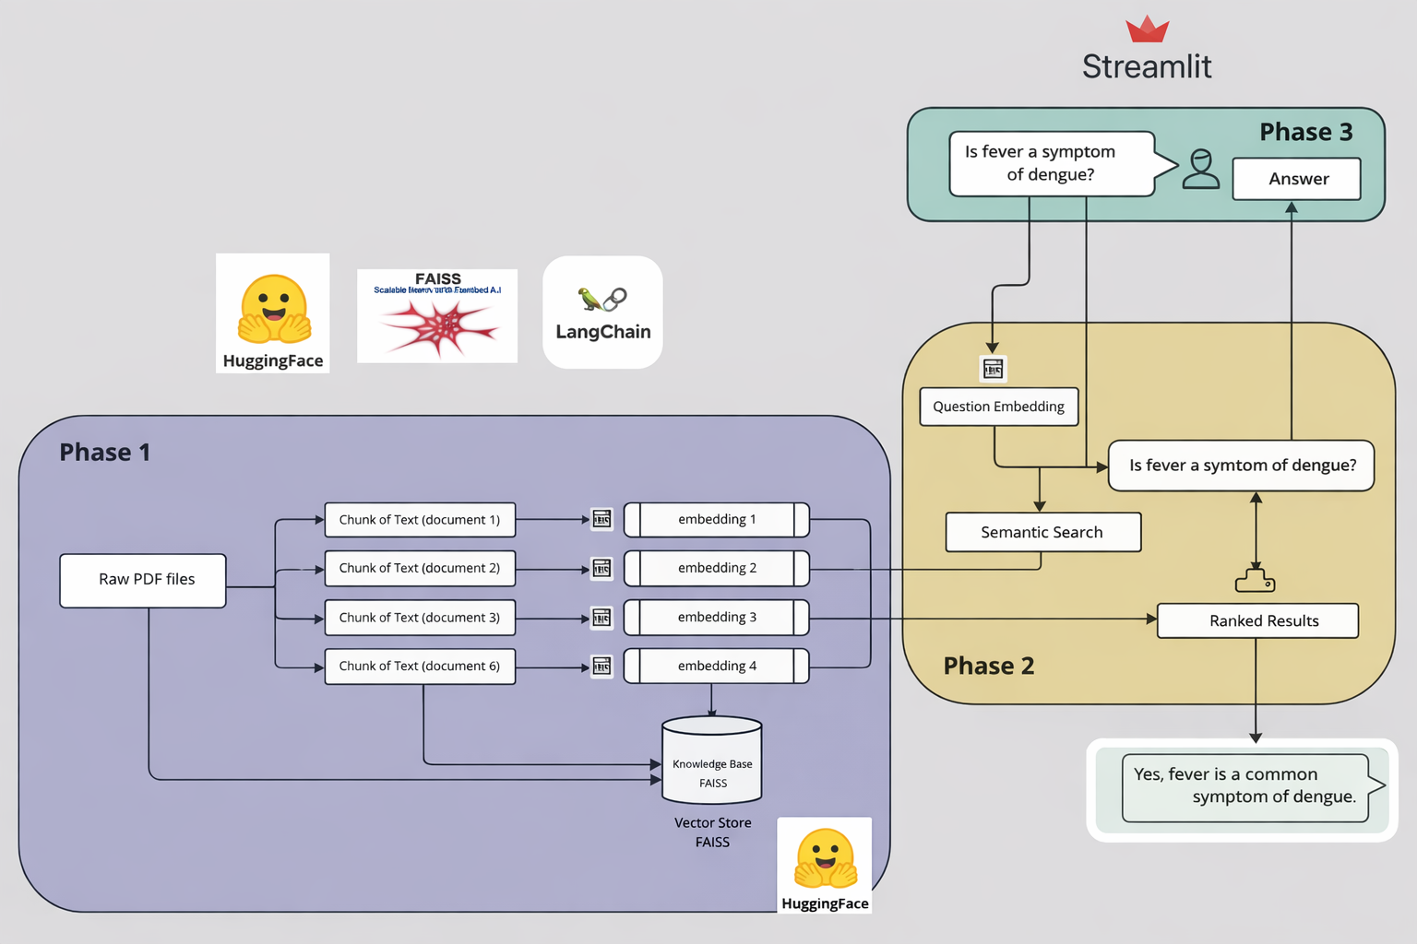
Architecture Diagram

Slide 14
Modules
1. Document Ingestion Module
This module is responsible for loading trusted medical PDF documents into the system. It extracts raw textual content from the documents and prepares them for further processing. It ensures that only verified and curated medical sources are used for knowledge generation.
2. Text Chunking Module
The extracted text is divided into smaller, meaningful chunks to preserve semantic context and improve retrieval accuracy. Chunking ensures that large documents are efficiently processed while maintaining contextual relevance during question answering.
3. Embedding Generation Module
Each text chunk is converted into numerical vector embeddings using pretrained embedding models. These embeddings capture the semantic meaning of the text and enable similarity-based retrieval during query processing.
4. Vector Storage Module (FAISS)
This module stores the generated embeddings in a FAISS vector database. It supports efficient and scalable semantic similarity search, allowing relevant document chunks to be retrieved quickly based on user queries.

Slide 15
Modules
5. Retrieval Module
When a user submits a query, this module converts the query into an embedding and performs semantic search over the FAISS vector database. It retrieves the most relevant document chunks required for generating a grounded response.
6. LLM Integration Module
This module integrates the Large Language Model (Mistral via HuggingFace) with the retrieved document context. The language model generates responses strictly based on the retrieved evidence, ensuring factual consistency and reducing hallucination.
7. RAG Orchestration Module
This module manages the end-to-end Retrieval-Augmented Generation pipeline by connecting retrieval and generation steps through LangChain. It ensures smooth coordination between the vector store, language model, and response generation.
8. User Interface Module (Streamlit)
The Streamlit-based user interface enables users to interact with the chatbot by entering queries and viewing responses. It also caches the vector store to optimize performance and provides a simple, accessible interface for end users.

Slide 16
Hardware and Software Details
Hardware Requirements
Standard personal computer or laptop
Minimum 8 GB RAM
CPU-based system (no dedicated GPU required)
Internet connectivity for model and library access
Software Requirements
Python 3.13 – Core programming language
LangChain – Framework for building RAG pipelines
HuggingFace – Model hub for LLM and embeddings
Mistral – Large Language Model for response generation
FAISS – Vector database for semantic search
Streamlit – Web-based chatbot user interface
VS Code – Integrated Development Environment

Slide 17
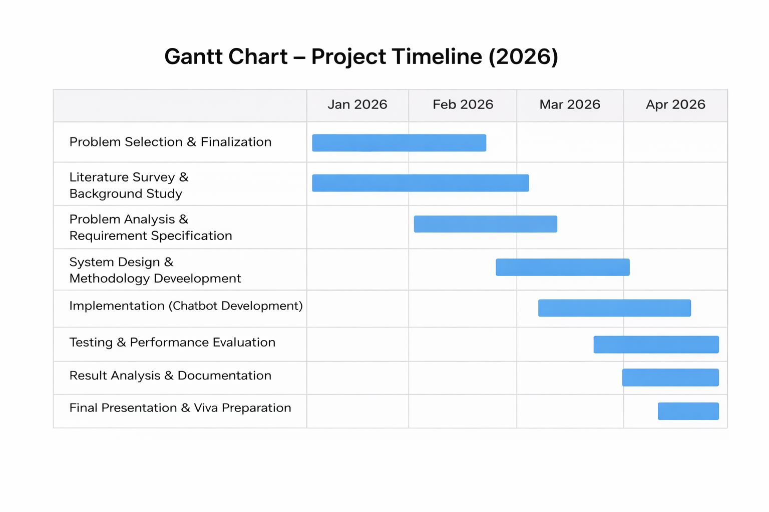
Timeline (Gantt Chart)

Slide 18
Github Link
https://github.com/Stu-Affan/Medical-Chatbot

Slide 19
REFERENCES
[1] Laranjo, L., Dunn, A.G., Tong, H.L., Kocaballi, A.B., Chen, J., Bashir, R., Surian, D., Gallego, B., Magrabi, F., Lau, A.Y.S. and Coiera, E., 2018. Conversational agents in healthcare: A systematic review. Journal of the American Medical Informatics Association, 25(9), pp.1248–1258.
[2]Bickmore, T.W., Trinh, H., Asadi, R. and Olafsson, S., 2018. Safety first: Conversational agents for health information. Journal of Biomedical Informatics, 82, pp.1–9.
[3]Wilson, L. and Marasoiu, M., 2022. The development and use of chatbots in public health: Scoping review. JMIR Human Factors, 9(4), e35882.
[4]Branda F, Stella M, Ceccarelli C, Cabitza F, Ceccarelli G, Maruotti A, Ciccozzi M, Scarpa F. The Role of AI-Based Chatbots in Public Health Emergencies: A Narrative Review. Future Internet. 2025; 17(4):145. https://doi.org/10.3390/fi17040145
[5]Singhal, K., Tu, T., Gottweis, J., Sayres, R., Wulczyn, E., Hou, L., Clark, K., Pfohl, S., Cole-Lewis, H., Neal, D., Schaekermann, M., Wang, A., Amin, M., Seneviratne, S., Wu, Z., Aratow, M., Prabhakaran, D., Gao, S., Narayan, R., and Corrado, G., 2023. Large language models encode clinical knowledge. Nature, 620, pp.172–180.

Slide 20
REFERENCES
[6]Ji, Z., Lee, N., Frieske, R., Yu, T., Su, D., Xu, Y., Ishii, E., Bang, Y.J., Madotto, A. and Fung, P., 2023. Survey of hallucination in natural language generation. ACM Computing Surveys, 55(12), pp.1–38.
[7]Lewis, P., Perez, E., Piktus, A., Petroni, F., Karpukhin, V., Goyal, N., Küttler, H., Lewis, M., Yih, W., Rocktäschel, T., Riedel, S. and Kiela, D., 2020. Retrieval-augmented generation for knowledge-intensive NLP tasks. Advances in Neural Information Processing Systems (NeurIPS), 33, pp.9459–9474.
[8]Izacard, G. and Grave, E., 2021. Leveraging passage retrieval with generative models for open domain question answering. Proceedings of the 16th Conference of the European Chapter of the Association for Computational Linguistics (EACL), pp.874–880.
[9]Miner, A.S., Laranjo, L. and Kocaballi, A.B., 2020. Chatbots in the fight against the COVID-19 pandemic. npj Digital Medicine, 3(65), pp.1–4.
[10]Devaraj, A., Sharma, A. and Ghosh, P., 2022. Evidence-based clinical decision support using natural language processing and retrieval systems. Journal of Biomedical Informatics, 128, 104002.

Slide 21


